Slide 1
Sprint 33 - Sprint Demo
HPE NFV Telco Blueprint
24th Jan 2020

Slide 2
Sprint 33 Demo - Agenda
# | Demo Topic | Presenter | Duration (Mins)
1 | Documentation E4 – Deployment Runbook and Compatibility Matrix walk through | Vaibhav Asha | 10
2 | Infra Highlights | Arun | 5
3 | QA QA Highlights Completed Tasks | Keerthy | 10
4 | VIM Highlights Openshift 4.2 installation and configuration with Nimble storage and RHEL as worker nodes | Nischith Uday | 20
5 | NPS Highlights Demo : Wrapper for NPS installation | Anusha Ashraf J | 10
6 | CEPH Storage Performance Scale out test RHOSP + CEPH Bluestore 3.3 +HDD as OSD (SSD as Journal ) | Ranjeet Tejas | 15

Slide 3
Documentation

Slide 4
Documentation Highlights
E4 Documentation – Vaibhav/Asha
Compatibility Matrix – First draft shared with QA team for first round of validation
Deployment Runbook – First draft shared with QA team for first round of validation

Slide 5
Infrastructure

Slide 6
Infrastructure Highlights
E4, C8 & C9:
S300 Training slide updated
C10:
BOM for DL325/385 Gen10 Plus for procurement
C9:
Infra related documents update with Nimble storage addition
BOM, Portmap, NW diagram, Rack diagram
SharePoint link
https://hpe.sharepoint.com/:f:/r/teams/NFV_engr/Blueprints/Shared%20Documents/Engineering/Releases/C9%20(RHOCP)/Infra?csf=1

Slide 7
QA

Slide 8
QA Highlights
C9
End to End Installation using Ephemeral storage
Functional Testing (Basic Sanity)
Automation of functional test cases
TICG validation with Nimble support
E4
TICG Validation
End to End Integration Testing

Slide 9
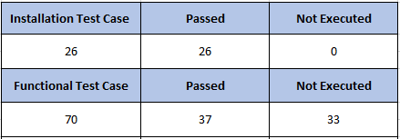
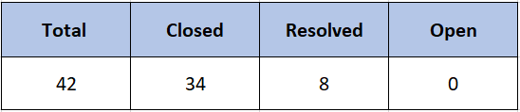
QA Tasks
C9
End to End Installation using Ephemeral Storage
Installation and Functional Test Statistics
Bug Statistics
Functional Test Automation
37 test cases were identified for the first set of automation, all has been automated
Few more test cases related to Nimble storage will be automated

Slide 10


QA Tasks
E4
TICG Validation
Verified the changes made for incorporating custom profile feature
Changes with respect to E4 hardware has been verified
End to End Integration Testing
Remote NPS Installation is in progress
Integration Test Statistics
Bug Statistics

Slide 11
VIM

Slide 12
VIM Highlights
E4 (RHOSP)
Automation support for Bluestore from nps-rhosp cli
nps-rhosp cli automation enhancement for NVMe as OSD
Automation changes to handle transition states from nps-rhosp cli
Schema validation changes for Bluestore configuration
C9 (RHOCP)
OpenShift 4.2 installation and configuration with Nimble storage and RHEL as worker nodes ( Demo )

Slide 13
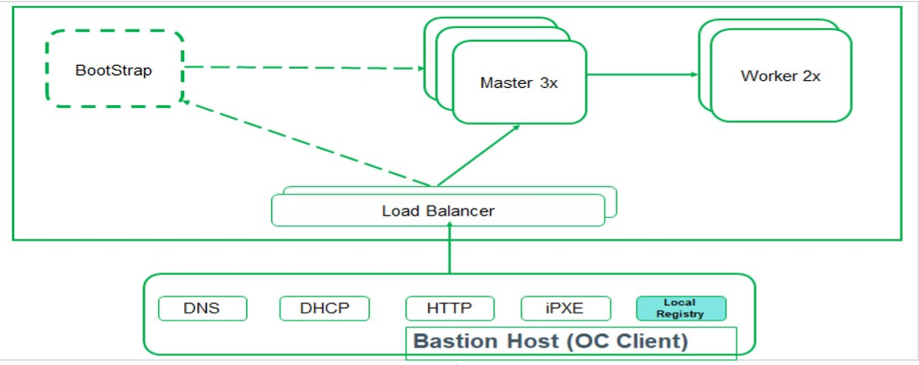
OpenShift Deployment Architecture

Slide 14
HPE CSI driver using Nimble as CSP
BootStrap
RHCOS
Worker 2x
RHCOS
Master 3x
RHCOS
Scale out
Worker
RHEL 7.6
Load Balancer
Load Balancer
NPS/Bastion Node
Quay.io
DNS
DHCP
HTTP
iPXE
Local Registry
Registry.redhat.io
RHEL 7 rpms

Slide 15
NPS

Slide 16
NPS Highlights
E4
Single NPS for RHOSP, RHOCP and VMWare
Switch automation
Enhancements to TICG
Wrapper for NPS VM installation
Hardware Prep for EL8k server
C9
Enhancements for Image service to support Multiple OS
Other tasks
Deployment of CFM as KVM instance
NPS-Bruce integration : Data model, CLI and API changes
Implementing new design for TICG
Demo
Wrapper for NPS installation

Slide 17
CEPH Performance

Slide 18
CEPH Performance highlights
Functional Area | High Level Activities
(RHOSP13+Ceph 3.3 BlueStore) | Completed Scale out test with 3, 4, 5 and 6 Ceph nodes (HDD as OSD) Client Load test with 10, 20, 40 VM's (HDD as OSD) Test with Write back cache enabled (SSD as OSD) UI Ceph Sizing Tool Effort estimation and Requirement Documentation In-Progress UI Sizing tool Basic Layout Next Steps Client Load Testing with Addition of Compute Node Ceph Nodes Scale Test with SSD as OSD (25G NIC, Gold CPU, NVMe as Journal ) Ceph Characterization for NVMe as OSD (25G NIC, Gold CPU) Sizing excel tool update with available HDD/SSD/NVMe data

Slide 19
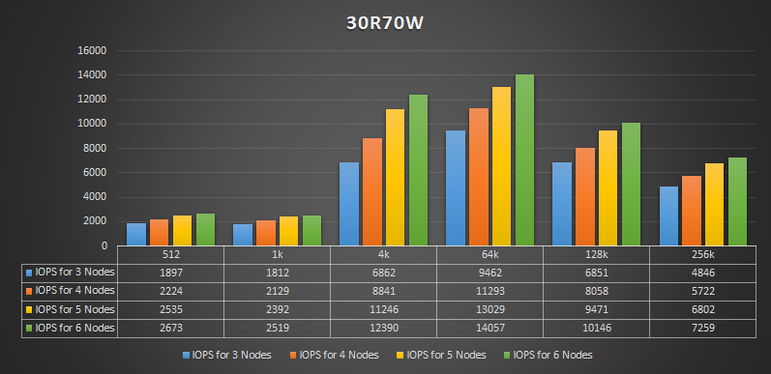
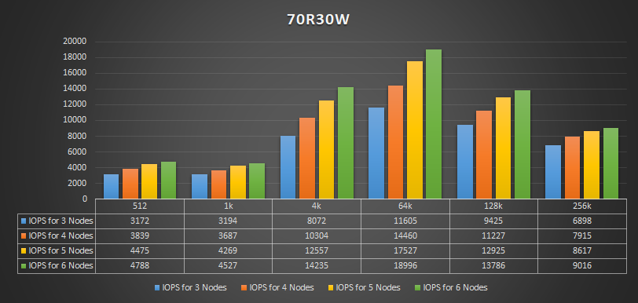
Scale out test results with 3, 4, 5 and 6 Ceph nodes (HDD as OSD) IOPS Comparison

Slide 20
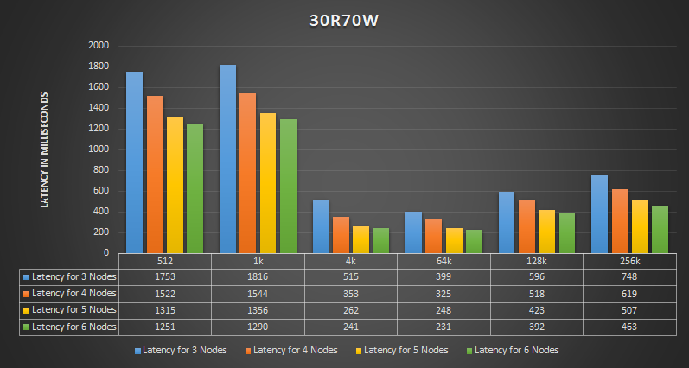
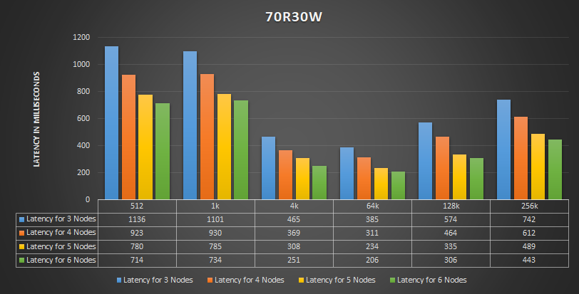
Scale out test results with 3, 4, 5 and 6 Ceph nodes (HDD as OSD) Read Latency Comparison

Slide 21
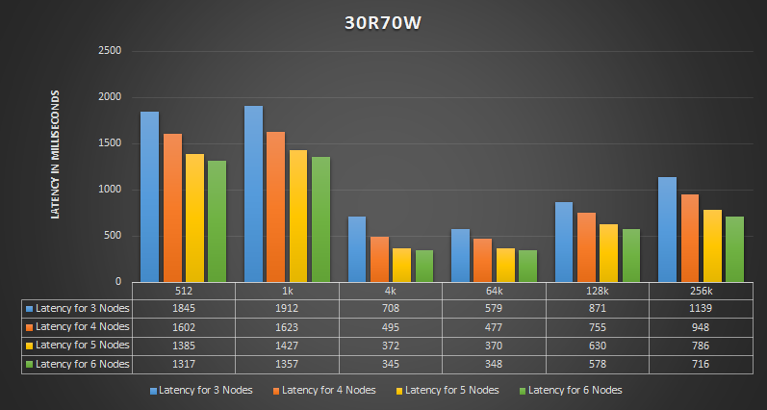
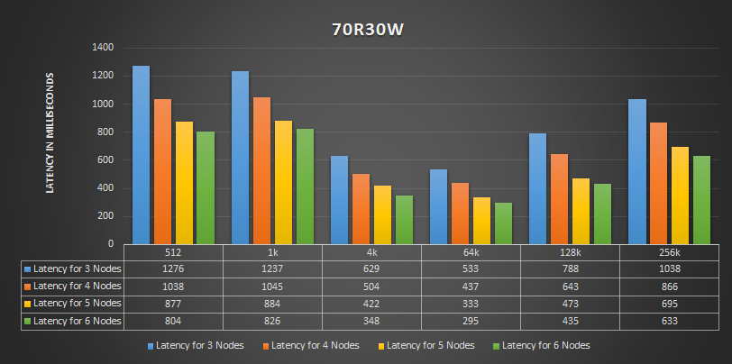
Scale out test results with 3, 4, 5 and 6 Ceph nodes (HDD as OSD) Write Latency Comparison

Slide 22
Scale out test Observations for IOPS and Latency (50R50W)
Block Size | % Change in IOPS from 3 Nodes to 6 Nodes | % Change in R-LAT from 3 Nodes to 6 Nodes | % Change in W-LAT from 3 Nodes to 6 Nodes
512 | 41% | -30% | -30%
1k | 38% | -30% | -30%
4k | 80% | -52% | -50%
64k | 56% | -43% | -43%
128k | 55% | -42% | -41%
256k | 51% | -42% | -40%

Slide 23
Client Load test observations with 10, 20, 40 VM's (50R50W)
4 Node Ceph Cluster Client Load Tests
Clients | Block Size | % Change in R-LAT from 10 Clients | % Change in W-LAT from 10 Clients | % Change in IOPS from 10 Clients
20 | 64k | 157% | 148% | 3%
40 | 64k | 286% | 259% | 22%
6 Node Ceph Cluster Client Load Tests
Clients | Block Size | % Change in R-LAT from 10 Clients | % Change in W-LAT from 10 Clients | % Change in IOPS from 10 Clients
20 | 64k | 89% | 84% | 24%
40 | 64k | 393% | 360% | 27%

Slide 24
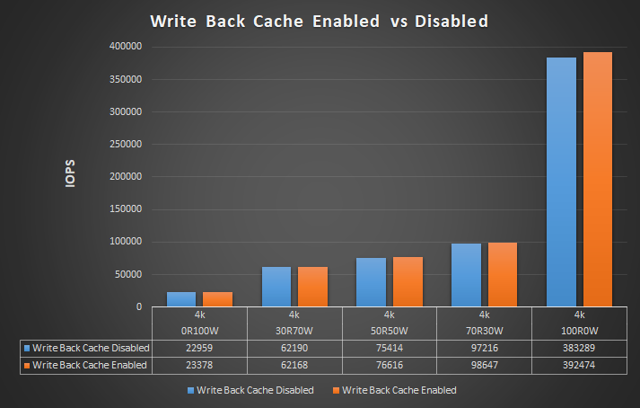
Write back cache Enabled vs Disabled (SSD as OSD)

Slide 25
Thank You

